Slide 1
Inmate Prison and Bias
Group Member:Yu-Jui Chang, Jingyi Xu, Wei -Chen Lu, Rongtao Ding

Slide 2

OverView
Introduction
Research Question
Method(Code)
Findings
Conclusions
Limits
Reference

Slide 3

Introduction
Prisoners were sentenced in the trials and trials in US have been questioned by public for long. The goal of this project is to find out whether the trials are bias or not through out the historical data from Inmate_Active_Oct_2020.csv, which records US inmate data from the year 1956 to 2020.

Slide 4
Research Question
What are the prison times for different ages, races and genders？
What relationship between detention time and age, sex, race if we consider all those three variable?

Slide 5
Method
Race, Sex, Age for our independent variables; Period in prison is response variable.
Drop ‘life sentence or death sentence’ cases in our dataset and other NA values in data set.
Diagnose the mode with normality and outliers.
Use the mutiple linear regression model to analyze the data.

Slide 6
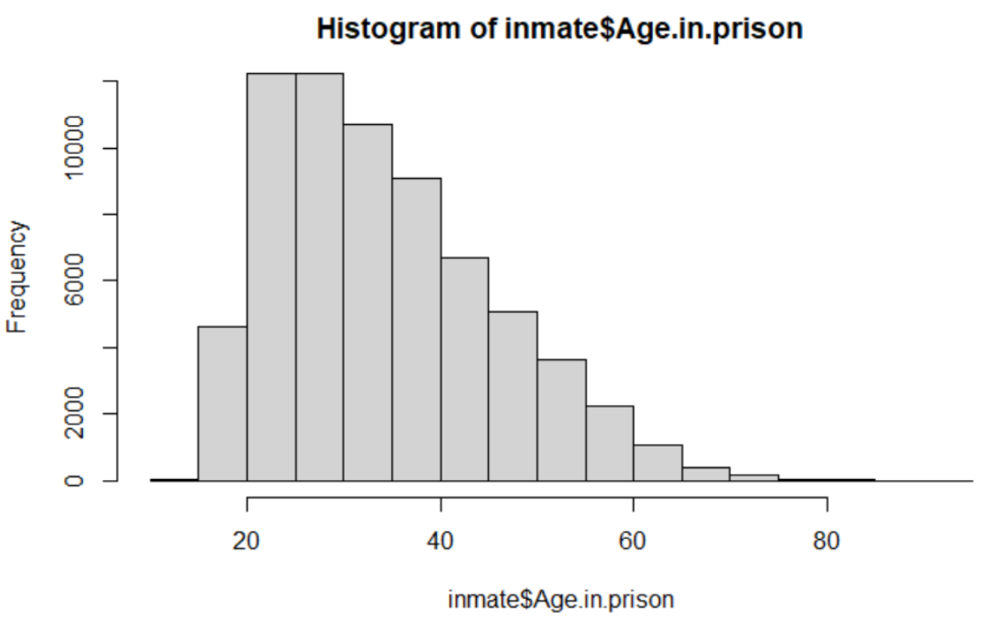
Age for Histogram
Right-skewed

Slide 7
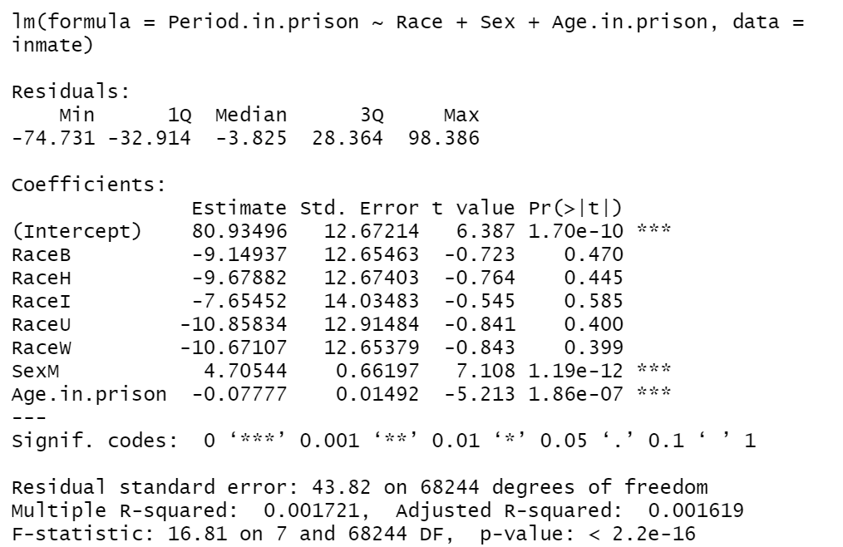
Regression Model #1
Period.in.prison = 80.93 - 9.14(RaceB) - 9.67(RaceH) - 7.6(RaceI) -10.85(RaaceU) - 10.67(RaceW) + 4.7(SexM) - 0.07(Age)

Slide 8
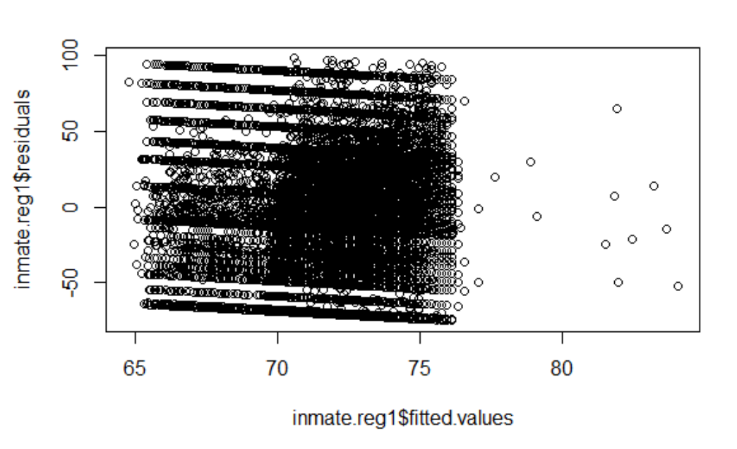
Residuals vs Y
The plot seems constant and no curve
Some line patterns in plot
Race, Sex, Period?

Slide 9
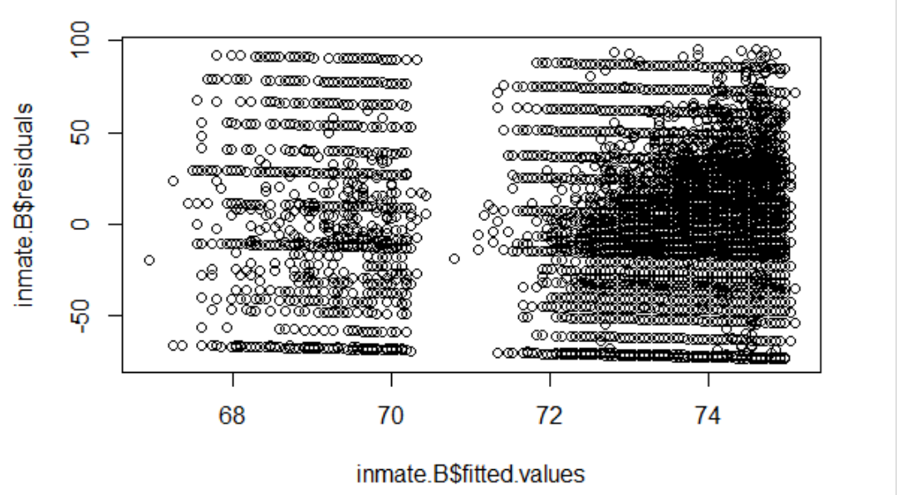
Plot Residuals Only Black Race
Still have line patterns
Two groups
Sex, Period?

Slide 10
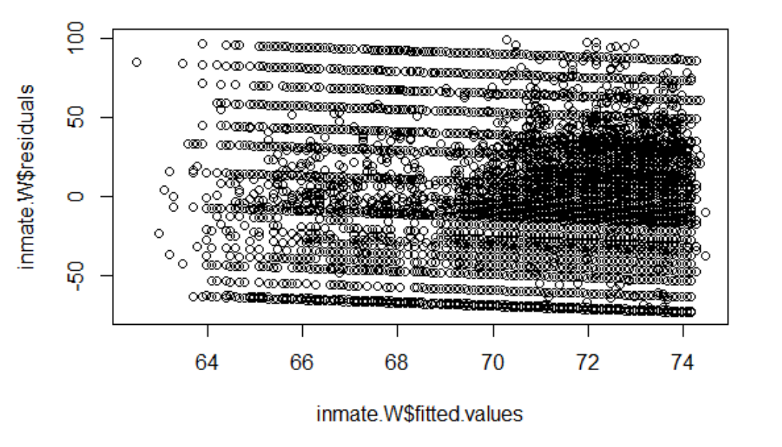
Plot Residuals Only White Race
Line patterns
Not obvious two groups

Slide 11
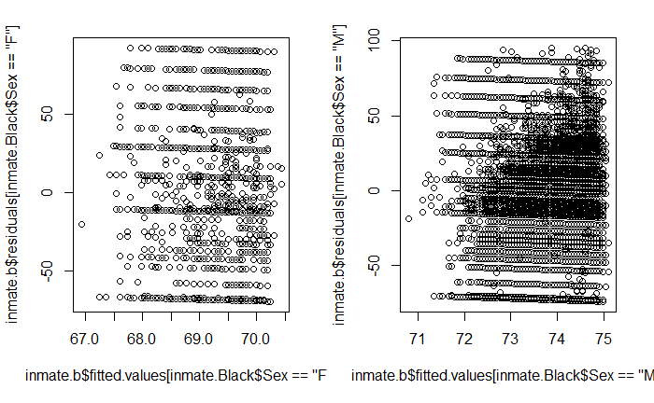
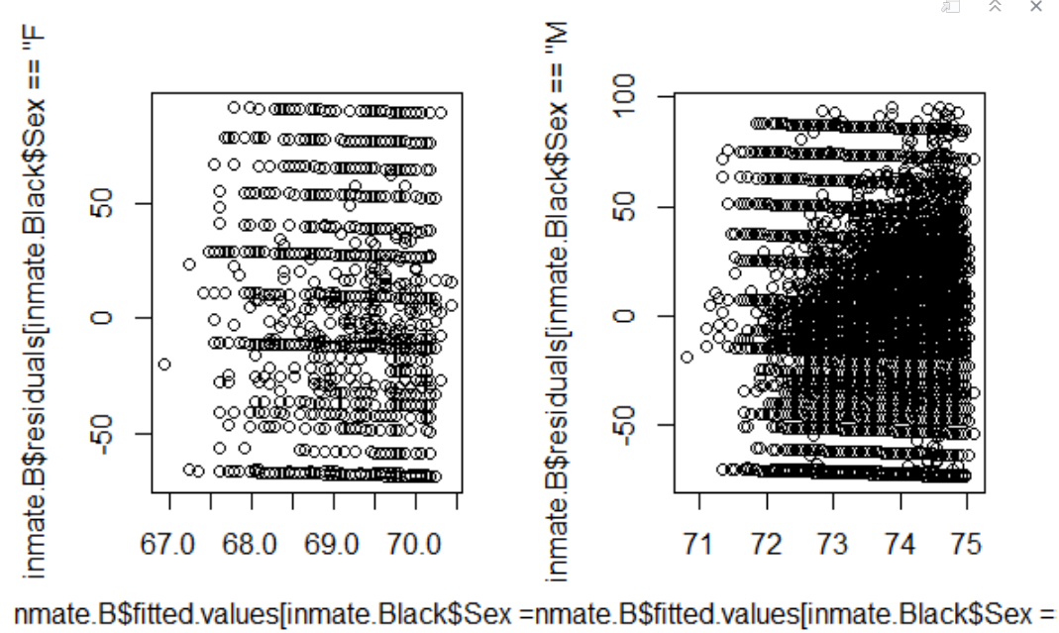
Plot Residuals Only Black Race (F vs M)
Solve two groups
Line patterns
Period?

Slide 12
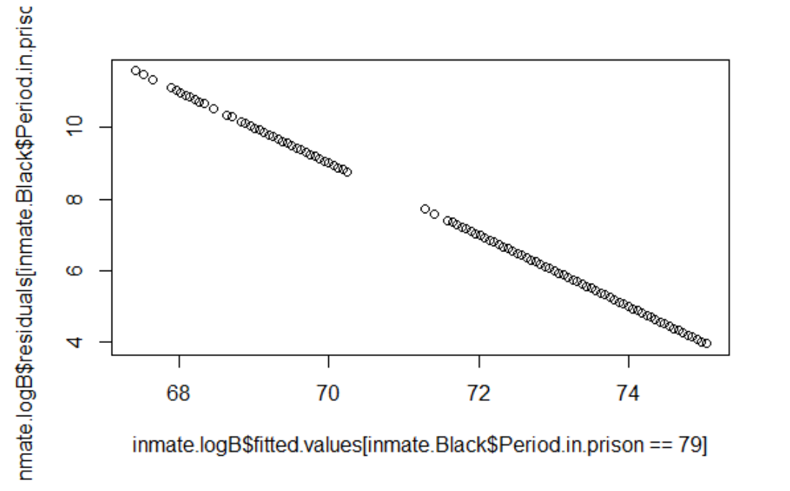
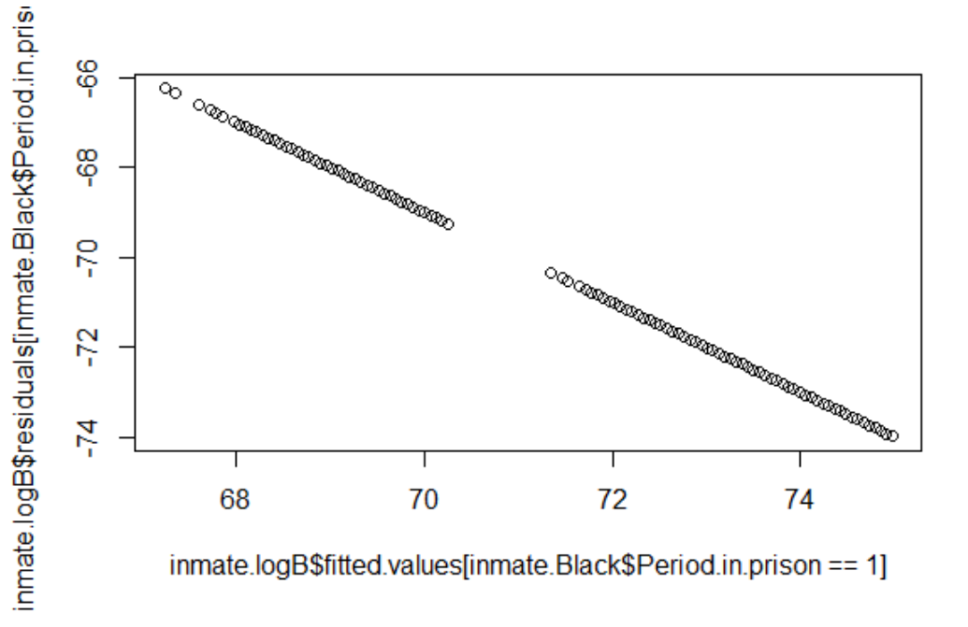
Plot Residuals for Period time 79 and 1
Find the reason of line patterns
Notes:
unique(period), around 100 different numbers, the number of observations is way larger than that of period in prison, making the plot into non- continuous.
For all obs with period= 79, their residuals = e = 79 - y_hat

Slide 13
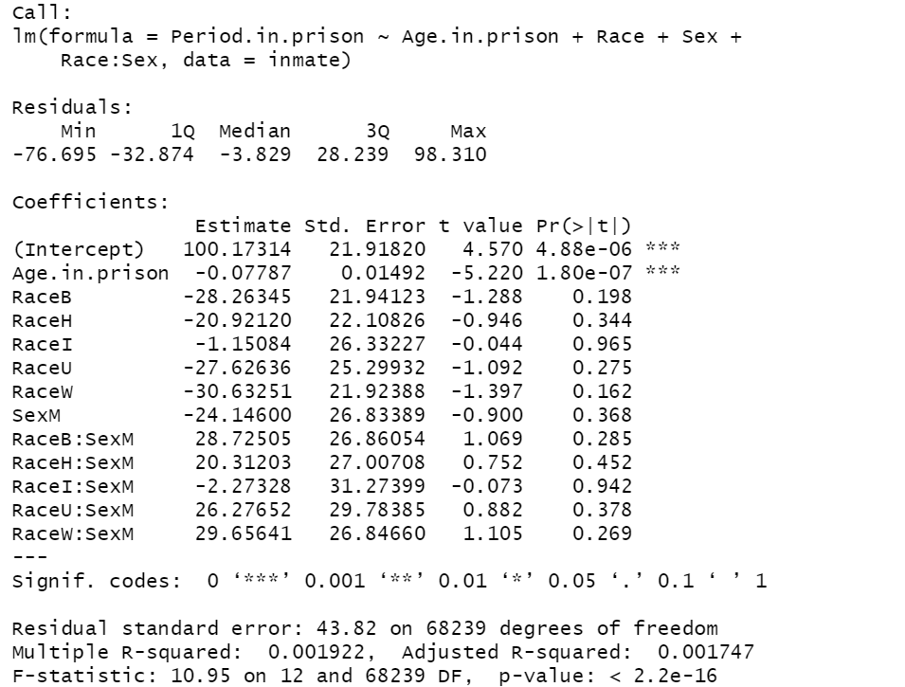
Interactions
Interaction with Race and Sex
There is no interaction between Race and Sex

Slide 14
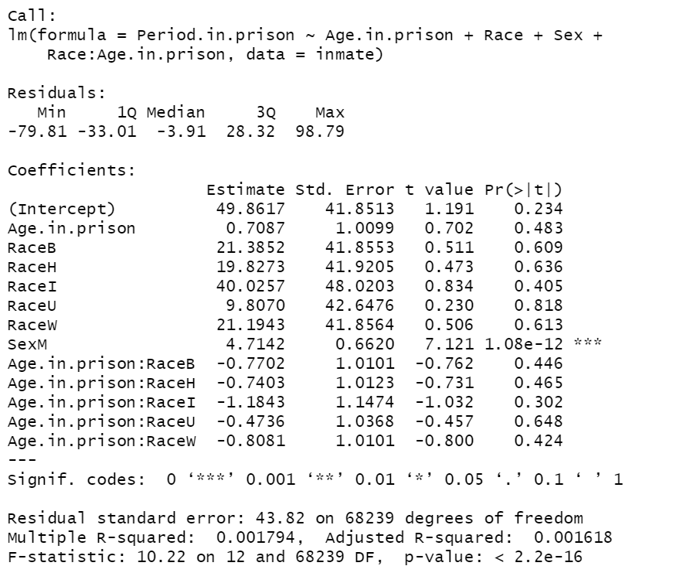
Interaction with Race and Age
Race and Age has no interaction
Sex in Male in this model is significant

Slide 15
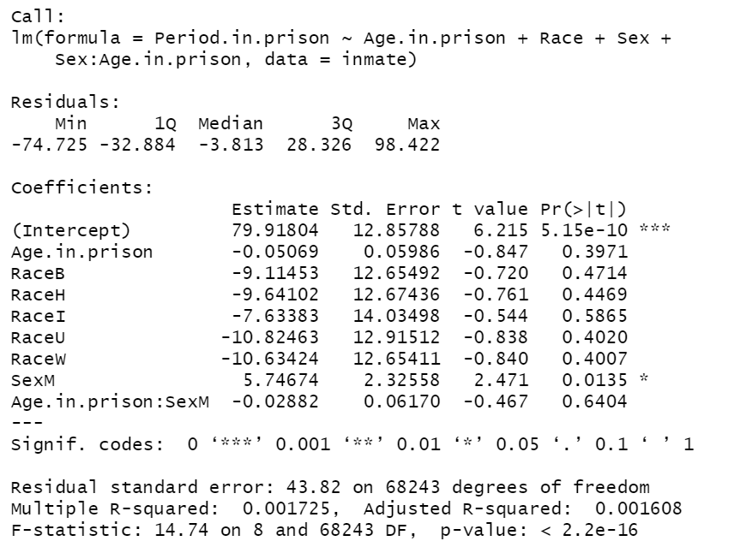
Intercation with Sex and Age
Sex and Age has no interaction
Sex in Male in this model is significant

Slide 16
Findings
The data reveals the fact that the most popular age range for people to be inmates is 20 to 30 year- old.
Male inmates tend to have longer time in jails.
The elder criminals tend to have shorter periods in prisons.
It seems no multicollinearity among Age.in.prison, Race and Sex.

Slide 17
Conclusions
Even though the multiple linear regression test is significant, the R-squared is not ideal, and the residual plot shows line pattern, meaning that at least one variable did not take into the model or there are non-known subgroups in the data set.
The Race variable has problem of unbalance . (Black and White cover 99% the observations.)
Unable to judge whether the justice is unfair or not due to lacking data of crime types.

Slide 18
Limitations
There is no data of how long the death sentenced inmates in jails before being executed.
There is no data to indicate whether the life sentenced prisoners were able to parole from jails or not, if so, there is no data that reveals how long did they detented either.
The project is limited by the nature of the data. To be more specific, there is no data to indicate whether the inmates were paroled or not, and when did they stay in jails.

Slide 19
It is hard to merge the crime term data to inmateidiviualy.(i.e. One inmate have multiple crimes in one trial or one trial has multiple defendants (sentenced as inmates.))
It is difficult to classify difference prison terms. (prison term 30000 contains all the crimes that are able to parole and maximum detention time lower than 3 year.)

Slide 20
Thank you for Listening!

Slide 21
Reference
https://www.merriam-webster.com/words-at-play/jail-vs-prison-difference
http://www.dc.state.fl.us/pub/obis_request.html
https://www.thoughtco.com/themis-goddess-of-justice-3529225

